Slide 1





Data Science Student Championship - South Zone
Dhruv Sharma
Student @ IIIT-Bangalore

Slide 2

Data Understanding
Dataset Introduction
There are two datasets , training dataset (shape = (134683, 21)) and test dataset (shape = (57722, 21))
Dataset contains rent prices of property in 8 cities namely Chennai , Hyderabad ,Kolkata, Mumbai, Pune , Delhi , Bangalore , Ahmedabad .
Dataset has 19 features/factors that determine the target (i.e Price) of a property represented by its unique PropertyID.
These features can be characterised into numerical(17) and categorical features(3) and a numerical target (price) .
Correlation analysis
Security deposit has strong correlation with the rent price (0.89) .
Availability of lift has a strong correlation with the number of floors (0.85 ) .
Houses that have air conditioning also tend to have washing machine (0.63)
Notes:
Learnings & how their approach can be applied to different use cases

Slide 3
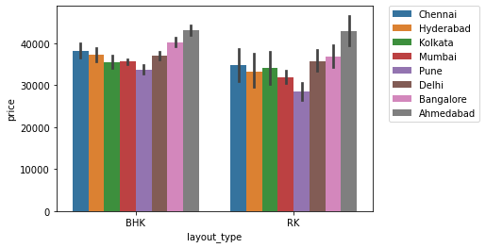
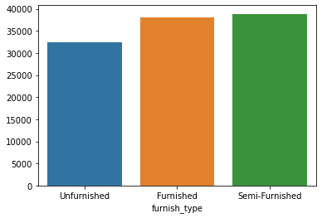

EDA of the dataset revealed some interesting facts about the housing market
BHK are costlier than RK in all the cities of the dataset .
Semi – furnished units are slightly costlier than furnished units . Unfurnished units are the most affordable on both metrics of mean and median .

Slide 4
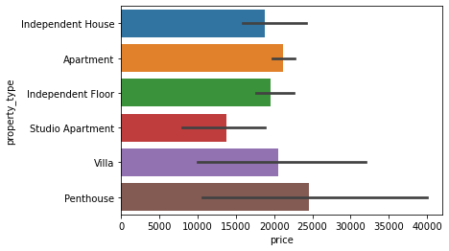
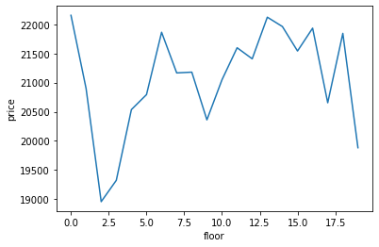
In general penthouses are the most expensive type of property with independent houses and floors also having high average rent prices. Studio units are the most affordable type of housing .(There is high variance in the prices of penthouses in different cities ) .
Interestingly , the rent of a house is NOT directly affected by the number of floors in the building .

Slide 5
Data Preparation
How missing values were handled?
No missing values
How were the outliers handled?
Cluster data into 2 parts , one cluster of approx. 3000 samples consists of very high rent prices ,clearly outliers .
Which new features / derived features were created from the data?
cust_type feature was created that indicated the cluster number of the sample.
How was feature selection done?
Feature selection was done using the SelectKMeans method of SkLearn library . It is used to select top k features that have highest correlation with the target.
Was binning required? If yes, why and how was it done?
Experimented with Binning on number of rooms ,number of bathrooms and neighboura in cross validation but it did not make any decrease in loss .
Notes:
Learnings & how their approach can be applied to different use cases

Slide 6
One of the most important steps in data preparation was – encoding categorical features
Experimented with different encoders like CountEncoder , TargetEncoder , OneHotEncoder and OrdinalEncoder . Rejected some of these encoders –
OneHotEncoder created a very big sparse dataset resulting in more than 3000 columns . This dataset was difficult to operate on .
Utilized a form of ordinal and TargetEncoder to get the best performance in cross validation .

Slide 7
Model Building & Evaluation
Utilized 3 types of models
Statistical Regression based model
Linear Regression , Lasso , RidgeCV
Tree Based model
Decision Tree model
Ensemble models
Random Forest , XGBoost , LightGBM
XGBoost ensemble along with hyper parameter tuning using hyperopt was utilized for the best predictions .
Notes:
Learnings & how their approach can be applied to different use cases

Slide 8
Hyper parameter tuning using hyperopt utilized in XGBoost and LightGBM .
colsample_bytree - 0.5084013079461859
eta - 0.5650000000000001
gamma - 6.134663657215085
max_depth - 4.0
min_child_weight - 2.0
reg_alpha - 111.0
reg_lambda - 0.6361814792928543
Model | CV(RMSE)
Linear Regression | 22034.268
RidgeCV Regression | 22157.308
Decision Tree Regressor | 30555.096
Random Forest Regressor | 21288.81
LightGBM Regressor | 20608.762
XGBoost Regressor | 19485.301

Slide 9
Results and Recommendations
Results
Pune was the cheapest city with median property rent of 17k and Ahmedabad was the most expensive city with median rent of 25k .
In any city , if looking for the cheapest option , RK and unfurnished houses have the lowest rents.
If you require bigger housing at lower prices , look in the suburban localities of the cities .
2nd , 3rd tier cities like Ahmedabad have also seen increase in rent prices ,may be due to WFH culture . Since most of the workforce in Tier 1 cities comes these cities , people are returning back to their homes resulting in higher prices.
Deployment Recommendations
Recommendations for deployment –
Utilize live deployment strategies to provide real-time predictions with minimum latency .
Create a joblib dump file / pickle file of the trained model .
Then load the model in the backend managed by flask/django framework and make prediction calls on the model .
Notes:
Learnings & how their approach can be applied to different use cases

Slide 10
Recommendations
A summary of the innovative and new ideas proposed based on the analysis.
Some ideas that can be drawn from the analysis are –
Instead of giving unfurnished houses on rent if a landowner semi furnishes or furnishes the house , and then puts it for rent , he/she tends to earn more .
We can create an agency that furnishes these unfurnished apartments at low costs to jack up the prices of these homes .
Notes:
Learnings & how their approach can be applied to different use cases

Slide 11
Recommendations
A summary of the important business outcomes /real life impact
Business Outcome
The application with the trained model as its brain can skip the middlemen like real estate agents and brokers and empower home buyers with the true rents in the area .
The model can be utilised to enable aspiring tenants to look for a place of rent , without the involvement of any real estate agents and there hefty brokerage fees .
Not only home buyers but real estate investors can also use the model to determine the estimate price of housing in the region they are interested in , way before starting a project .
Potential customers using this application can be –
1) Students not living in their college campuses / attending coaching classes in different cities .
2) People who WFH and do not like to get tied down to a place .(Younger generation generally) .
3) People who have low income and cannot afford to buy houses .
Notes:
Learnings & how their approach can be applied to different use cases

Slide 12
Solving real-world business problems in house rental spaces
Rental business has two entities
Home Owner
Tenant
Problem faced by homeowner
Deciding price
Problem faced by tenant
Security
Neighbourhood
Rent

Slide 13
Ideas to increase revenue in house rental business
Concentrate increasingly on Tier – 2 and Tier – 3 cities for rental properties.
Put furnished or semi-furnished houses on rent .
Add power backup to your property .
Add air conditioning and washing machine .
Charging pet fees .

Slide 14
THANK YOU

